Slide 1
Work and Energy in Electric Fields

Slide 2
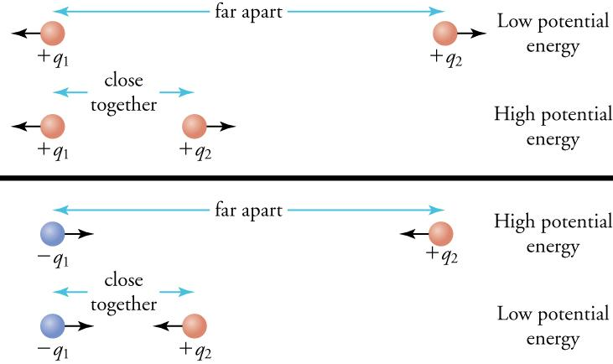
Work and Energy in Electric Fields
In physics, work is the energy transferred to or from an object as a force is applied by another object over a displacement. It is measured in joules (J).
When moving charges or charged objects within electric fields:
Work must be done to a charge to move it against an electric field – in doing so, the charge gains electric potential energy.
This is similar to lifting an object in a gravitational field.
When allowed to move with an electric field, the object producing the field does work on the charge. The charge’s electric potential energy turns back into kinetic energy.
(Assume that q₁ and –q₁ are fixed)
Notes:
Your textbook says that work is done “on” or “by” the field, which is a fairly common way of talking about things at this level but doesn’t make a huge amount of sense when you think about it. A field is not an object that you can apply a force to, nor can it be displaced. It’s easier to think of potential energy as being stored within the charge or charged object. (That said, I concede that talking about the force of the field on the particle can be helpful if you don’t want to consider the object/s producing the field.)
There’s a great article on work and electric potential at https://www.khanacademy.org/science/electrical-engineering/ee-electrostatics/ee-fields-potential-voltage/a/ee-electric-potential-voltage if you want a more thorough explanation.

Slide 3
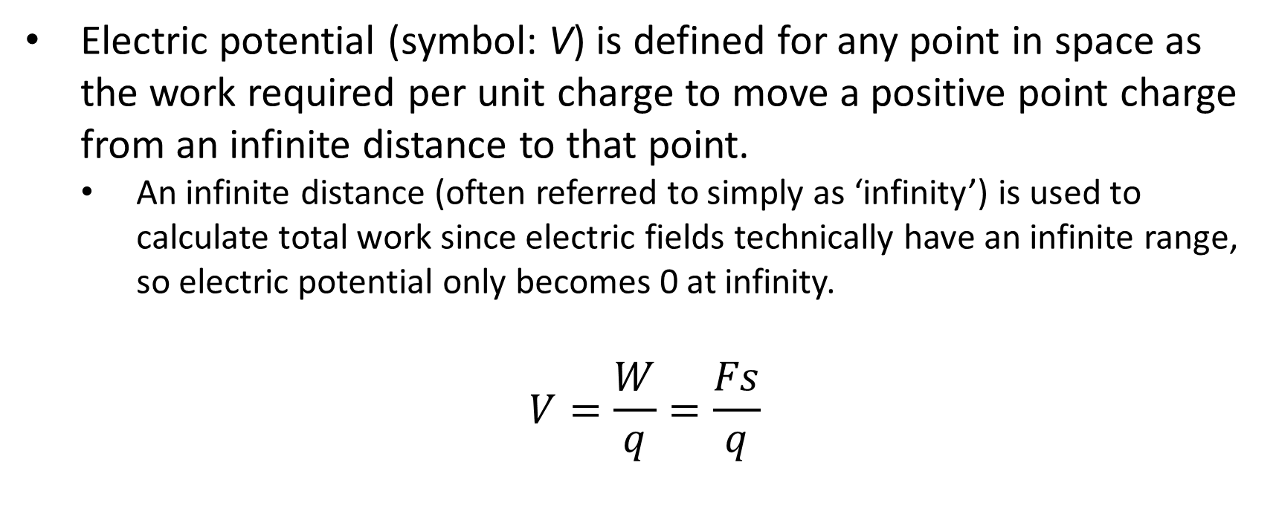
Electric Potential
Electric potential (symbol: V) is defined for any point in space as the work required per unit charge to move a positive point charge from an infinite distance to that point.
An infinite distance (often referred to simply as ‘infinity’) is used to calculate total work since electric fields technically have an infinite range, so electric potential only becomes 0 at infinity.
$$V=\frac{W}{q}=\frac{Fs}{q}$$
Notes:
That ‘infinite range’ can be clearly seen in Coulomb’s law – no matter how big r is, F will never quite reach 0. Same goes for gravity!
The formula is given as W = Vq on the formula sheet.

Slide 4
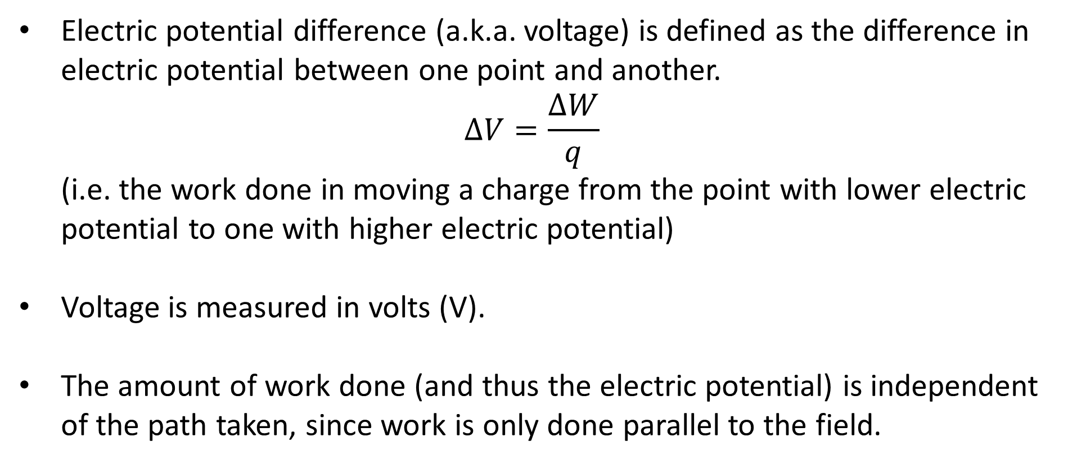
Electric Potential Difference
Electric potential difference (a.k.a. voltage) is defined as the difference in electric potential between one point and another.
$$ΔV=\frac{ΔW}{q}$$
(i.e. the work done in moving a charge from the point with lower electric potential to one with higher electric potential)
Voltage is measured in volts (V).
The amount of work done (and thus the electric potential) is independent of the path taken, since work is only done parallel to the field.
Notes:
This is similar to gravity: it doesn’t matter what path you take to lift an object, it always ends up with the same amount of gravitational potential energy.

Slide 5
Zero Potential
Any point connected by a conductor to the Earth is said to have zero potential (a.k.a. ‘grounded’ or ‘earthed’).
The Earth is essentially a neutral object, so it produces no electric field, and no work is done as a charge approaches it.
Notes:
This is similar to an object resting on the ground having zero gravitational potential energy.

Slide 6
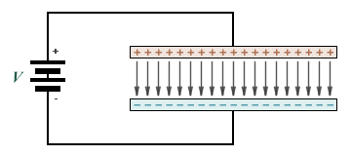
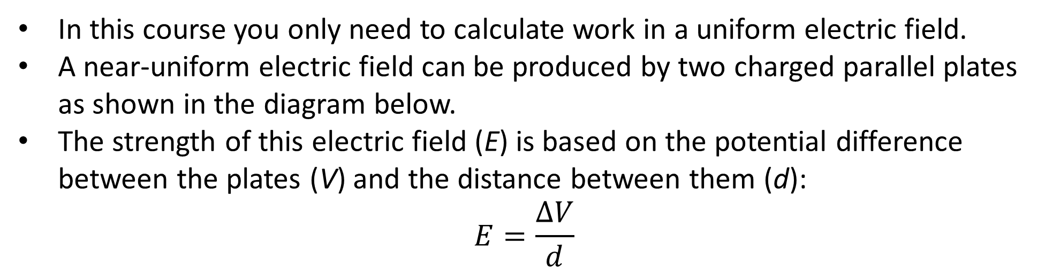
Uniform Electric Fields
In this course you only need to calculate work in a uniform electric field.
A near-uniform electric field can be produced by two charged parallel plates as shown in the diagram below.
The strength of this electric field (E) is based on the potential difference between the plates (V) and the distance between them (d):
$$E=\frac{ΔV}{d}$$
Notes:
Hooray for not having to integrate!

Slide 7
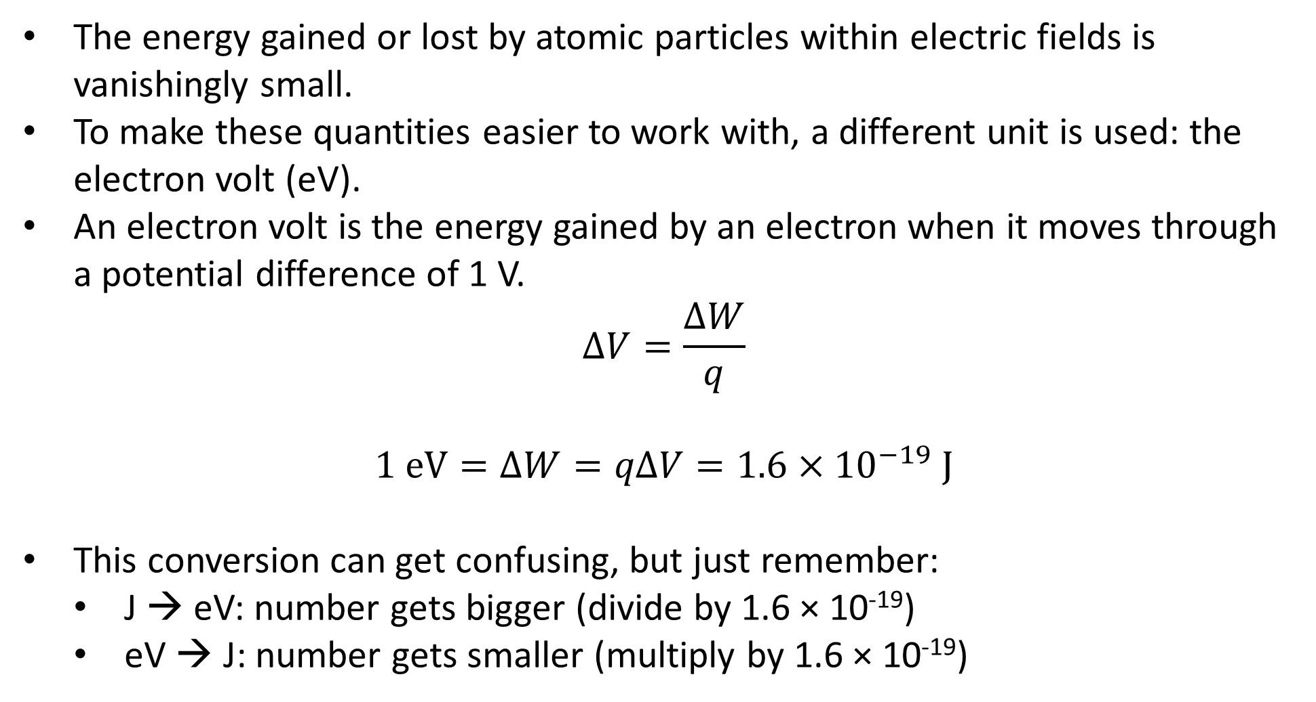
Electron Volts
The energy gained or lost by atomic particles within electric fields is vanishingly small.
To make these quantities easier to work with, a different unit is used: the electron volt (eV).
An electron volt is the energy gained by an electron when it moves through a potential difference of 1 V.
$$ΔV=\frac{ΔW}{q}$$
$$1 \text{eV}=ΔW=qΔV=1.6×{10}^{−19} \text{J}$$
This conversion can get confusing, but just remember:
J → eV: number gets bigger (divide by 1.6 × 10⁻¹⁹)
eV → J: number gets smaller (multiply by 1.6 × 10⁻¹⁹)

Slide 8
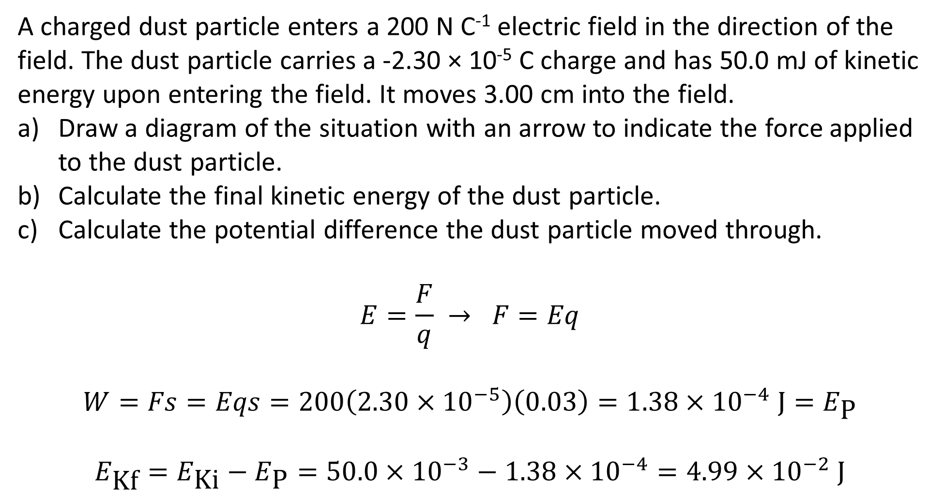
Example
A charged dust particle enters a 200 N C⁻¹ electric field in the direction of the field. The dust particle carries a -2.30 × 10⁻⁵ C charge and has 50.0 mJ of kinetic energy upon entering the field. It moves 3.00 cm into the field.
Draw a diagram of the situation with an arrow to indicate the force applied to the dust particle.
Calculate the final kinetic energy of the dust particle.
Calculate the potential difference the dust particle moved through.
$$E=\frac{F}{q} → F=Eq$$
$$W=Fs=Eqs=200\left(2.30×{10}^{−5}\right)\left(0.03\right)=1.38×{10}^{−4} \text{J}=E_{\text{P}}$$
$$E_{\text{Kf}}=E_{\text{Ki}}−E_{\text{P}}=50.0×{10}^{−3}−1.38×{10}^{−4}=4.99×{10}^{−2} \text{J}$$
Notes:
You may notice that work should be negative here since F and s are in opposite directions, and that q has mysteriously turned positive.
Both of these things can be explained by the fact that work is actually the scalar (dot) product of F and s, so should be calculated W = || F || || s || cos θ, where θ is the angle between F and s. So yes, W should be negative since cos 180° = -1, but q becoming positive is actually correct because magnitude can’t be negative.
You don’t need to know all that, but you do need to use your knowledge of the concepts taught earlier in this lesson to determine that the work done on the particle should be subtracted from its kinetic energy, which is what part a) is trying to guide you towards.

Slide 9
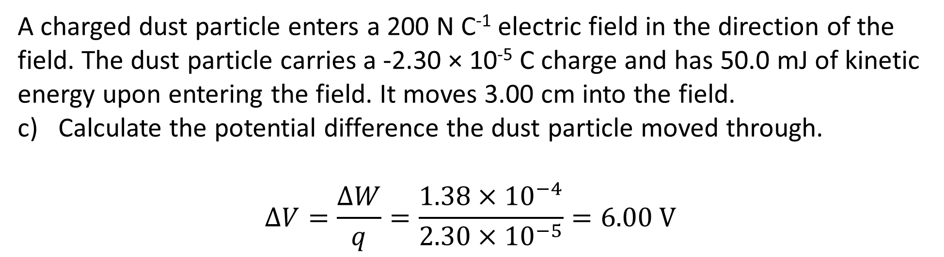
Example
A charged dust particle enters a 200 N C⁻¹ electric field in the direction of the field. The dust particle carries a -2.30 × 10⁻⁵ C charge and has 50.0 mJ of kinetic energy upon entering the field. It moves 3.00 cm into the field.
Calculate the potential difference the dust particle moved through.
$$ΔV=\frac{ΔW}{q}=\frac{1.38×{10}^{−4}}{2.30×{10}^{−5}}=6.00 \text{V}$$
Notes:
…and if work was negative here, we wouldn’t have to mess with the charge to get a positive answer. However, on slide 3 we defined PD as “the work done in moving a charge from the point with lower electric potential to one with higher electric potential”, which has to be positive in this situation.

